Slide 1
MA478: Final Project Proposal
CDT Isabella Palchak
CDT Karly Parcell
9 April 2024

Slide 2
Chicago Data
Spatial data that consists of 552 Census block groups
Variable of interest: Burglaries
Number of burglaries by block for each month between 2010-2014
Covariates:
Population
Measure of unemployment
Measure of wealth
Number of 15-20 yr males
Average monthly precipitation 2010-2014

Slide 3
Problem Statement
Develop and choose a model with DIC that best captures the effect population, wealth, and monthly precipitation on burglaries by census block in Chicago.

Slide 4
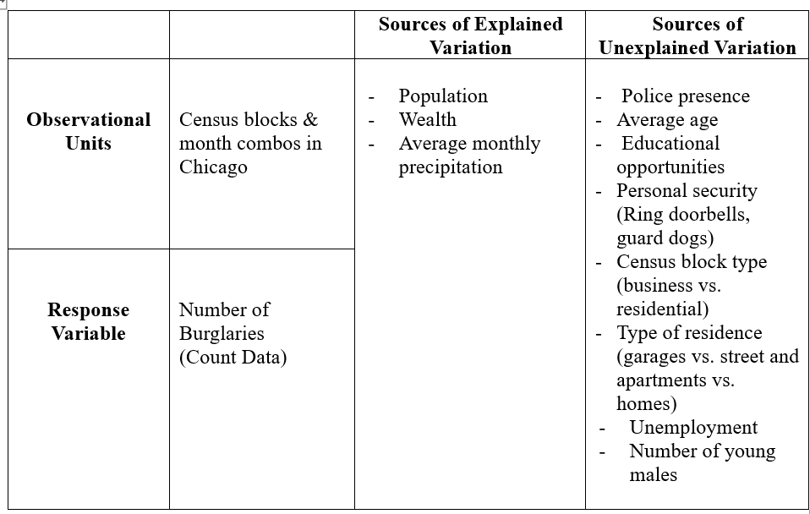
Sources of Variation

Slide 5
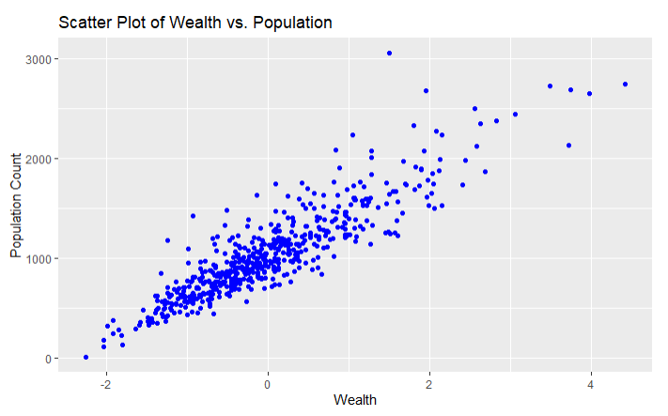
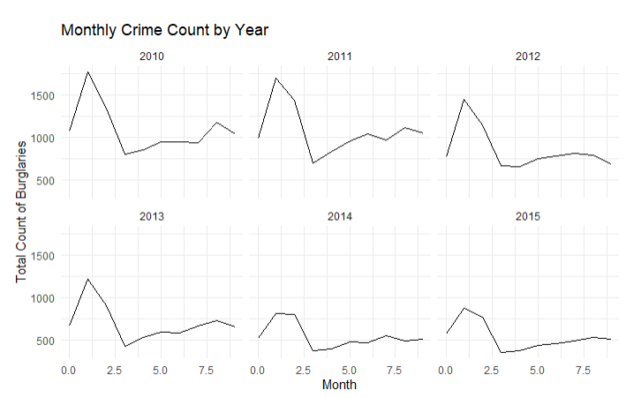
Initial Data Exploration
Number of burglaries by block for each month between 2010-2014
Population
Measure of wealth
Average monthly precipitation 2010-2014

Slide 6
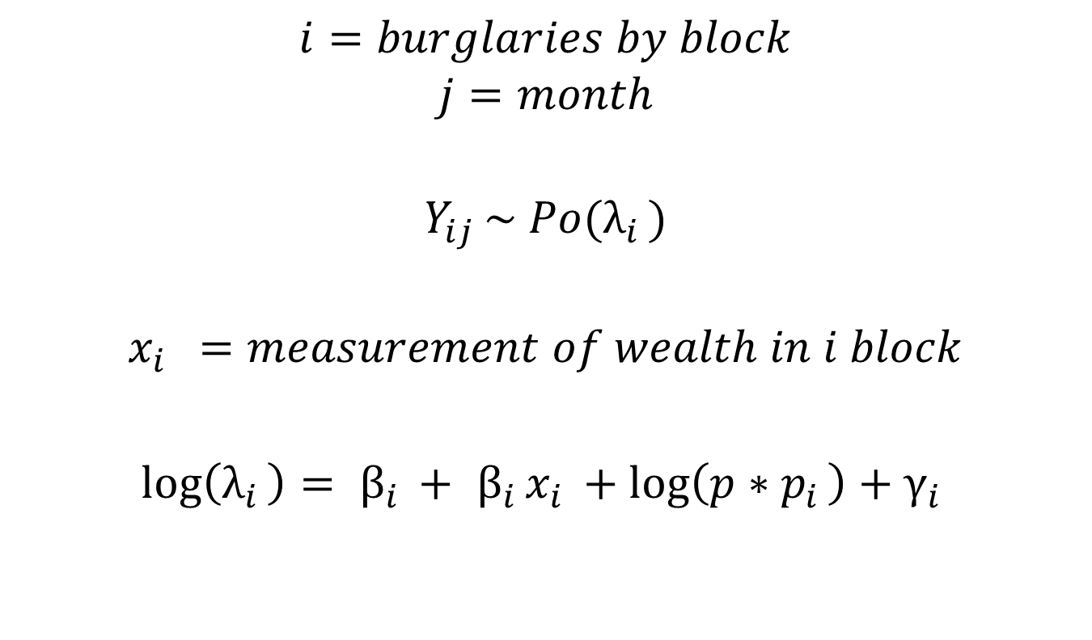
Poisson Mixed Effects Model
$$i=burglaries by block$$
$$j=month$$
$$Y_{ij }\sim Po(λ_{i })$$
$$x_{i } =measurement of wealth in i block$$
${\log\left(λ_{i }\right)= β}_{i }+$ ${ β}_{i }x_{i }+\log\left(p∗p_{i }\right)+γ_{i }$

Slide 7
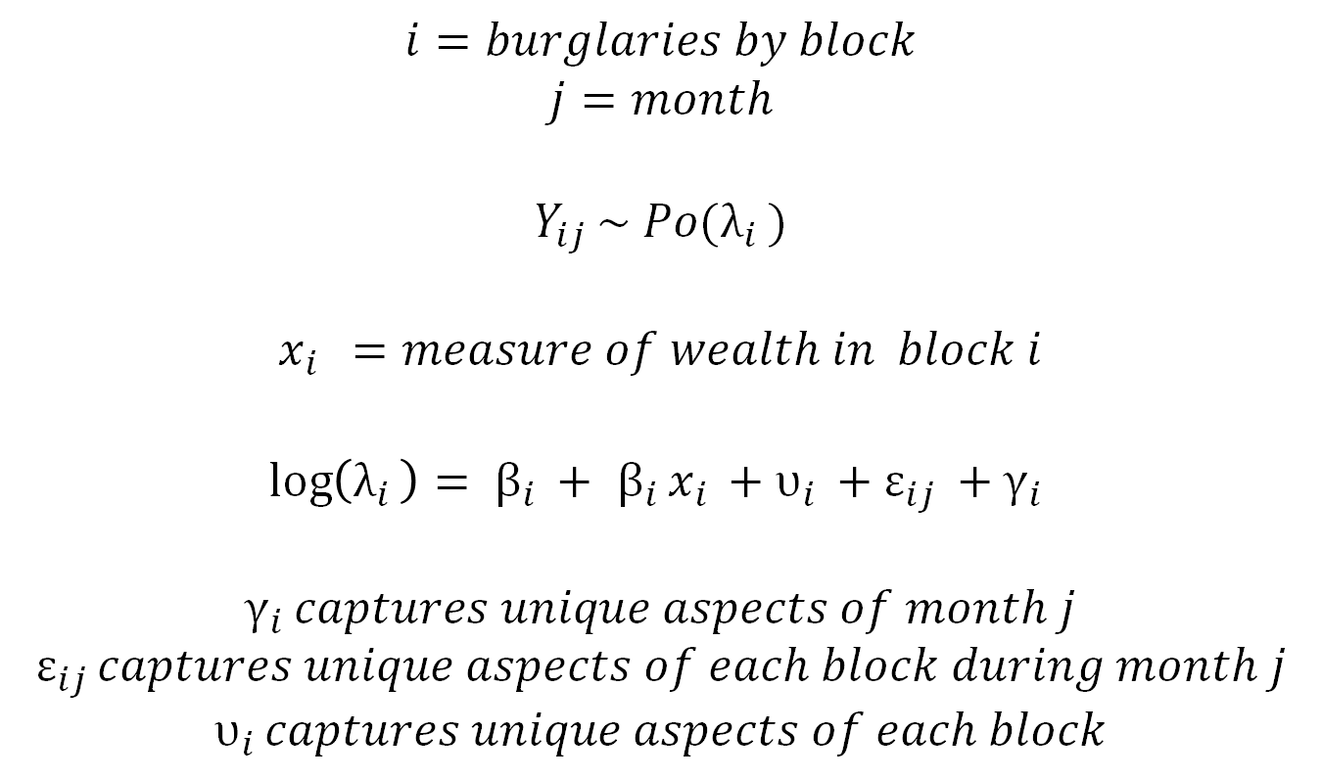
Poisson Random Effects Model
$$i=burglaries by block$$
$$j=month$$
$$Y_{ij }\sim Po(λ_{i })$$
$$x_{i } =measure of wealth in block i$$
${\log\left(λ_{i }\right)= β}_{i }+$ ${ β}_{i }x_{i }+υ_{i }+ε_{ij }+γ_{i }$
$$γ_{i }captures unique aspects of month j$$
$$ε_{ij }captures unique aspects of each block during month j$$
$$υ_{i }captures unique aspects of each block$$

Slide 8
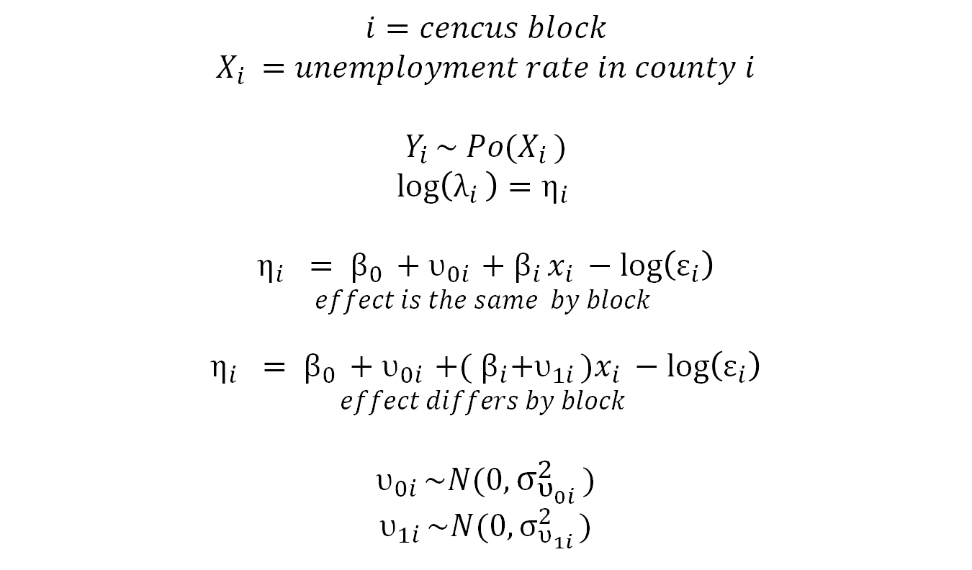
Spatial Model
$$i=cencus block$$
$$X_{i }=unemployment rate in county i$$
$$Y_{i }\sim Po(X_{i })$$
$$\log\left(λ_{i }\right)=η_{i }$$
$${η_{i } = β}_{0 }+υ_{0i }+{ β}_{i }x_{i }−log\left(ε_{i}\right)$$
$$effect is the same by block$$
$${η_{i } = β}_{0 }+υ_{0i }+{( β}_{i}+υ_{1i })x_{i }−log\left(ε_{i}\right)$$
$$effect differs by block$$
$$υ_{0i }\sim N(0,σ_{υ_{0i }}^{2})$$
$$υ_{1i }\sim N(0,σ_{υ_{1i }}^{2})$$

